Slide 1
Long Short-Term Memory (LSTM).

Slide 2
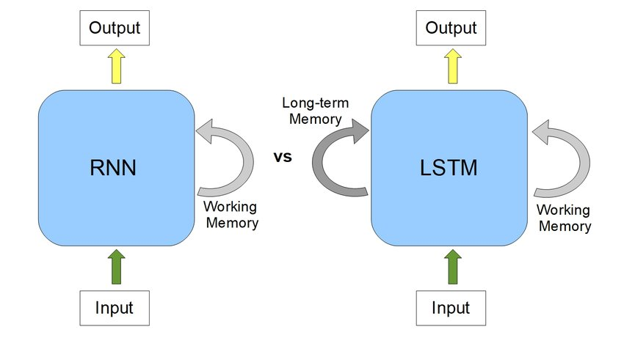
RNNs use their internal state (memory) to process sequences of inputs
Long Short-Term Memory (LSTM) network is a variant of RNN, with additional long term memory to remember past data.

Slide 3
To address the exploding gradient and vanishing gradient problems, architectures like Long Short-Term Memory (LSTM) are designed to handle long-term dependencies.
LSTMs introduce a gating mechanism that controls how information is stored, passed, or forgotten in the network

Slide 4
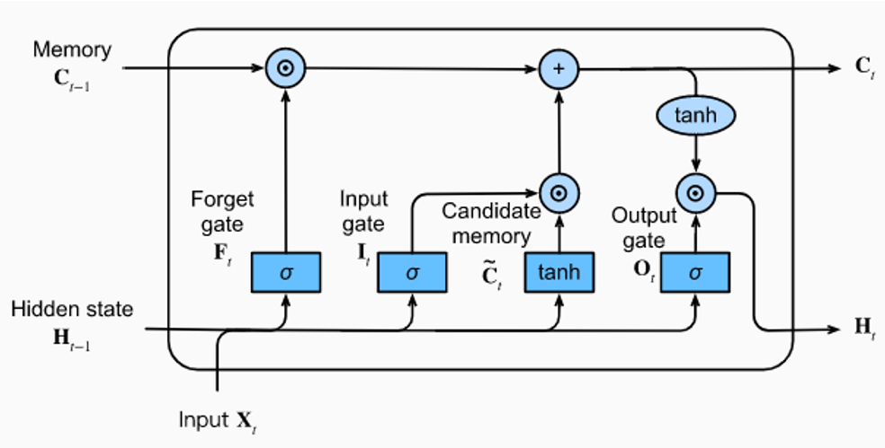

Slide 5
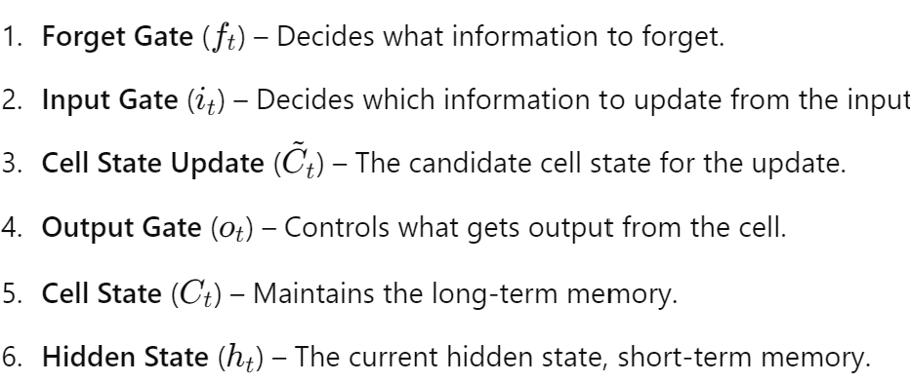


Slide 6
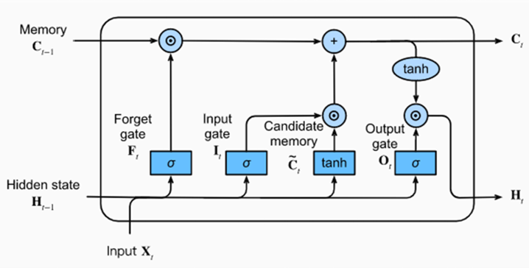
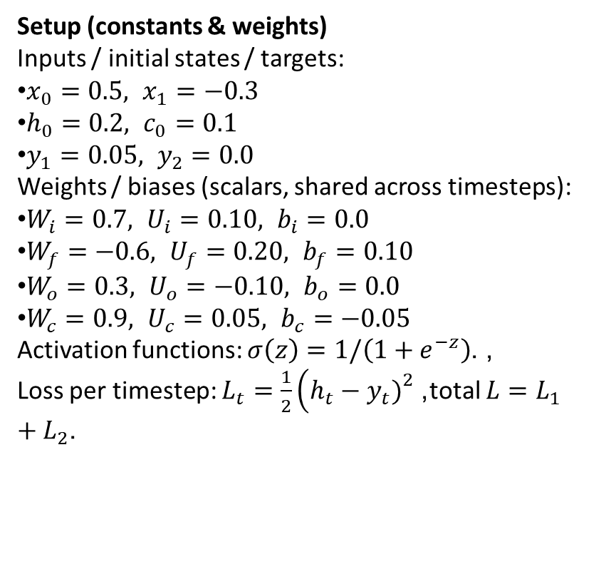
Setup (constants & weights)
Inputs / initial states / targets:
$x_{0}=0.5, x_{1}=−0.3$
$h_{0}=0.2, c_{0}=0.1$
$y_{1}=0.05, y_{2}=0.0$
Weights / biases (scalars, shared across timesteps):
$W_{i}=0.7, U_{i}=0.10, b_{i}=0.0$
$W_{f}=−0.6, U_{f}=0.20, b_{f}=0.10$
$W_{o}=0.3, U_{o}=−0.10, b_{o}=0.0$
$W_{c}=0.9, U_{c}=0.05, b_{c}=−0.05$
Activation functions: $σ\left(z\right)=1/\left(1+e^{−z}\right)$, . Loss per timestep: $L_{t}=\frac{1}{2}\left(h_{t}−y_{t}{\left.)\right.}^{2}\right.$, total $L=L_{1}+L_{2}$.

Slide 7
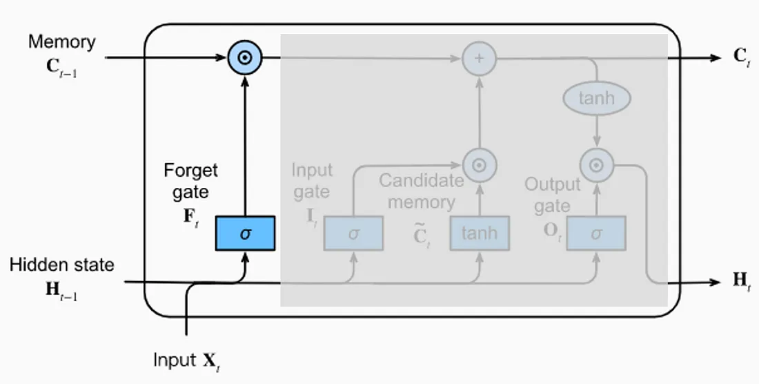
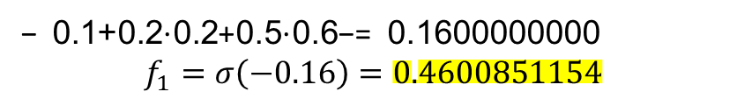
LSTM Forward Pass Example
The forget gate tells the network
how much of the previous cell state
to forget.
For time step t=1
=−0.6⋅0.5+0.2⋅0.2+0.1 − 0.1600000000 $$f_{1}=σ\left(−0.16\right)=0.4600851154$$

Slide 8
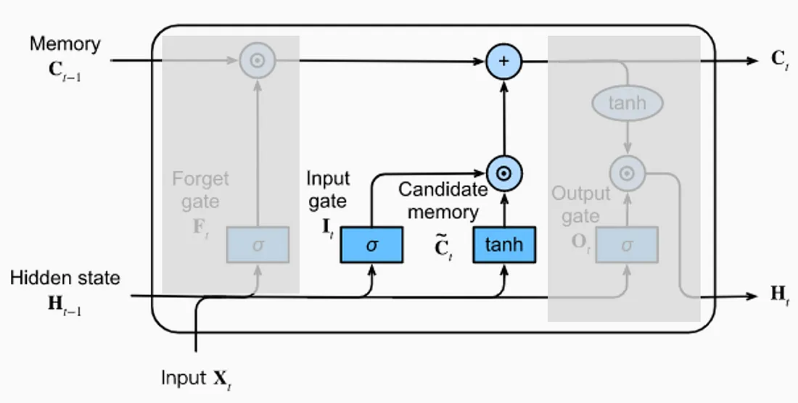
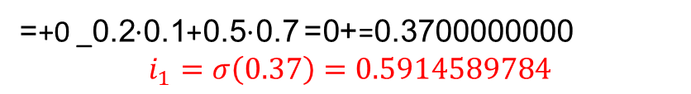
LSTM Forward Pass Example
The input gate controls how much o
f the new candidate state to store.
For time step t=1
Candidate memory output neurons use hyperbolic tangent function. The properties of this function ensure that all values of the candidate vector are between -1 and 1. This is used to normalize the information that will be added to the cell state.
C (tilda)=0.9⋅0.5+0.05⋅0.2−0.05=0.4100000000
=tanh(0.41)=0.3884726802
=+0 _0.7⋅0.5+0.1⋅0.2 +0==0.3700000000 $$i_{1}=σ\left(0.37\right)=0.5914589784$$

Slide 9

LSTM Forward Pass Example
The candidate state controls how much
new information to be added
For time step t=1
C (tilda)=0.9⋅0.5+0.05⋅0.2−0.05=0.4100000000
=tanh(0.41)=0.3884726802
=+0 _0.7⋅0.5+0.1⋅0.2 +0==0.3700000000 $$i_{1}=σ\left(0.37\right)=0.5914589784$$
c1​=f1​c0​+i1​ctilda1​=0.4600851154⋅0.1+0.5914589784⋅0.3884726802
=0.2757741661

Slide 10
LSTM Forward Pass Example
The cell state controls how much
new information to be added
For time step t=1
=0.2757741661=0.28
Cell state C at time t1 how much to forget + How much to add

Slide 11
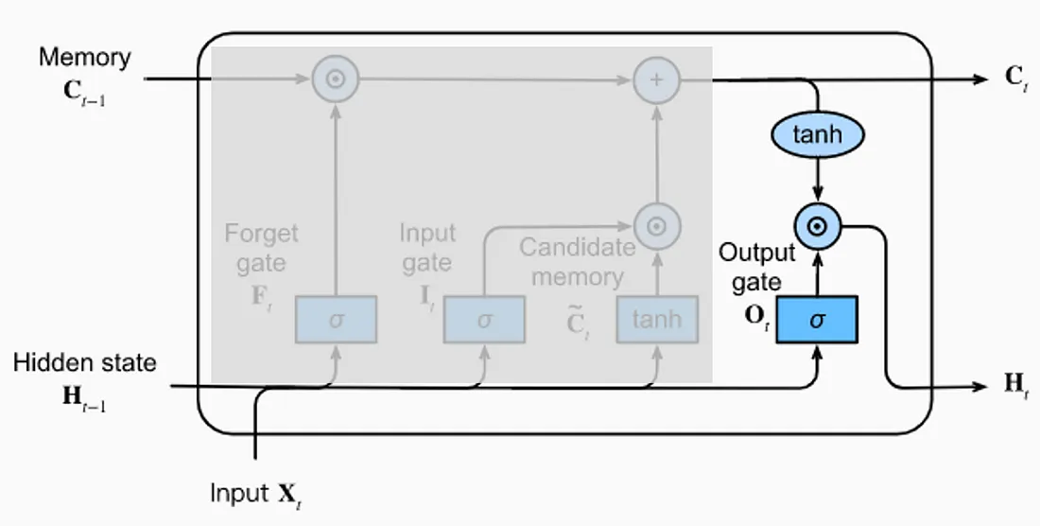
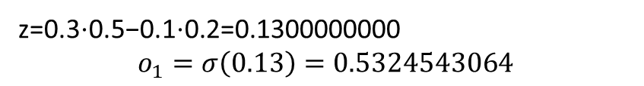
LSTM Forward Pass Example
The output gate tells the network
how much of the previous cell state
to forget.
For time step t=1
z​=0.3⋅0.5−0.1⋅0.2=0.1300000000 $$o_{1}=σ\left(0.13\right)=0.5324543064$$

Slide 12
tanh(c1​)=0.268989482
h1​=o1​tanh(c1​)=0.5324543064⋅0.2689894825=0.1432246084
L1​=21​(h1​−y1​)²=0.5⋅(0.1432246084−0.05)²=0.004345413801

Slide 13
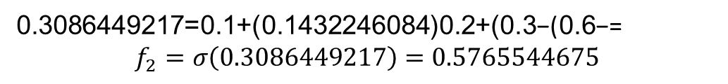
LSTM Forward Pass Example
The forget gate tells the network
how much of the previous cell state
to forget.
For time step t=2
=−0.6(−0.3)+0.2(0.1432246084)+0.1=0.3086449217 $$f_{2}=σ\left(0.3086449217\right)=0.5765544675$$

Slide 14
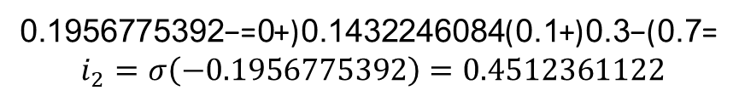
LSTM Forward Pass Example
The input gate controls how much o
f the new candidate state to store.
For time step t=1
Candidate memory output neurons use hyperbolic tangent function. The properties of this function ensure that all values of the candidate vector are between -1 and 1. This is used to normalize the information that will be added to the cell state.
C(tilda)=0.9(−0.3)+0.05(0.1432246084)−0.05=−0.3128387696
tanh(−0.3128387696)=−0.3030174248
=0.7(−0.3)+0.1(0.1432246084)+0=−0.1956775392 $$i_{2}=σ\left(−0.1956775392\right)=0.4512361122$$

Slide 15
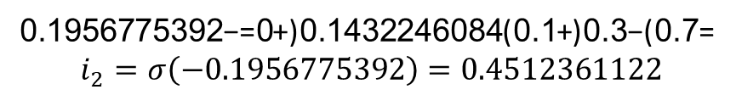
LSTM Forward Pass Example
The candidate state controls how much
new information to be added
For time step t=2
C(tilda)=0.9(−0.3)+0.05(0.1432246084)−0.05=−0.3128387696
tanh(−0.3128387696)=−0.3030174248
=0.7(−0.3)+0.1(0.1432246084)+0=−0.1956775392 $$i_{2}=σ\left(−0.1956775392\right)=0.4512361122$$
c2​==f2​c1​+i2​ctilda2​=0.5765544675⋅0.2757741661+0.4512361122⋅(−0.3030174248)=0.0222664228

Slide 16
LSTM Forward Pass Example
The cell state controls how much
new information to be added
For time step t=2
0.0222664228

Slide 17
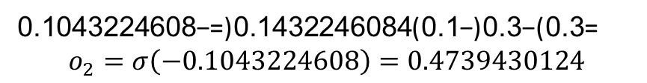
LSTM Forward Pass Example
The output gate tells the network
how much of the previous cell state
to forget.
For time step t=2
=0.3(−0.3)−0.1(0.1432246084)=−0.1043224608 $$o_{2}=σ\left(−0.1043224608\right)=0.4739430124$$

Slide 18
tanh⁡(𝑐2)=0.0222621381
ℎ2=o2​tanh(c2​)=0.4739430124⋅0.0222621381=0.0105512718
L2​=1/2​(h2​−y2​)²= =0.5⋅(0.0105512718−0)2=0.00005566466
Total loss: $L=L_{1}+L_{2}=0.004401078469$

Slide 19
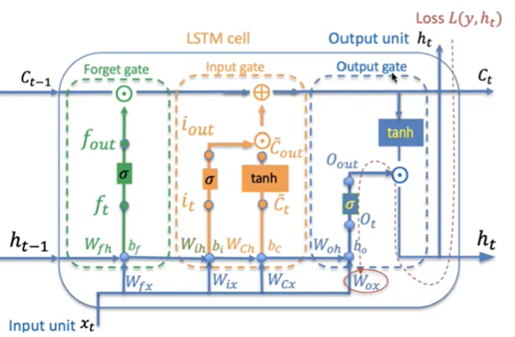
Using Backpropagation LSTM learns long-term dependencies more effectively

Slide 20
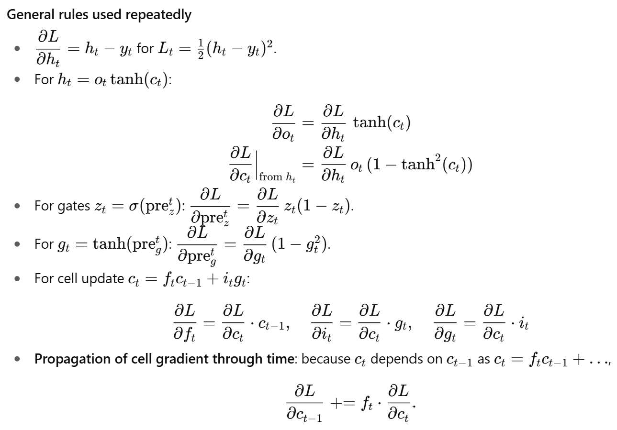

Slide 21
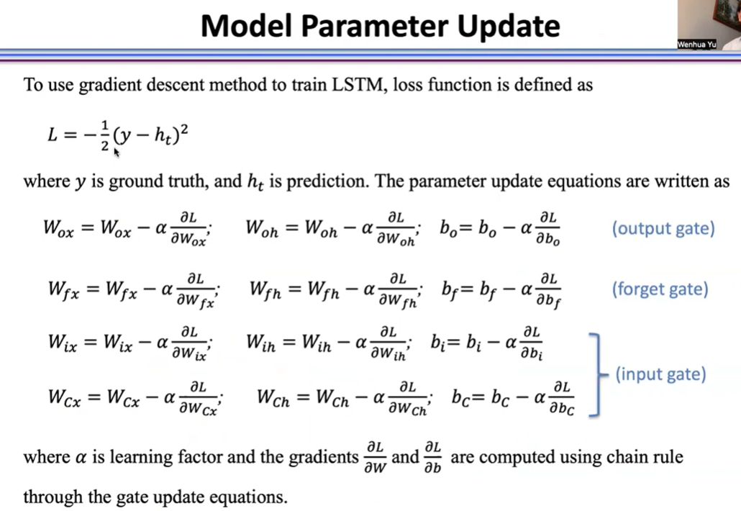

Slide 22
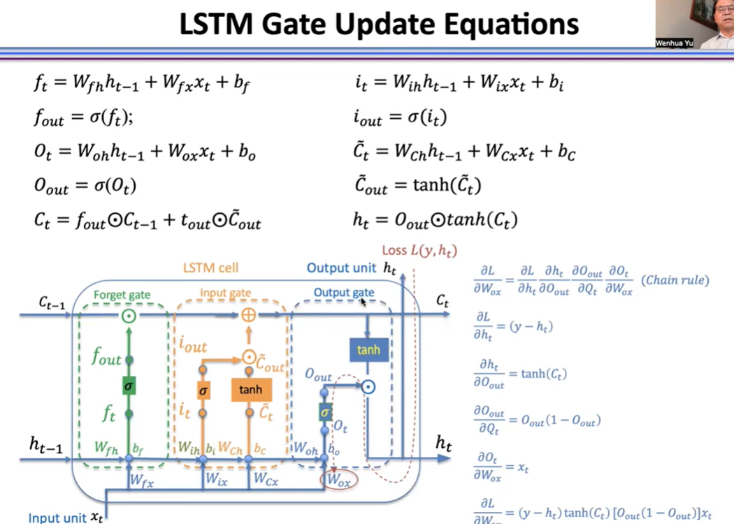

Slide 23
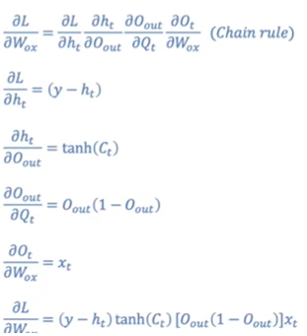
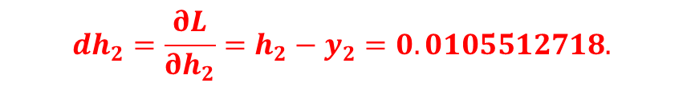
1. Gradient of Loss with Respect to Hidden State
$$dh_{2}=\frac{∂L}{∂h_{2}}=h_{2}−y_{2}=0.0105512718.$$

Slide 24


1. Gradient of Loss with Respect to Hidden State

Slide 25
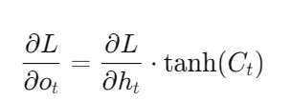
2. Gradient of Loss with Respect to output gate
From ℎ2=𝑜2tanh⁡(𝑐2)
𝑑h2 w.r.t to o =(𝑑l w.r.t. to ℎ2)⋅tanh⁡(𝑐2)=0.0105512718⋅0.0222621381=0.0002344809.
𝑑(z𝑜2)=𝑑𝑜2⋅𝑜2(1−𝑜2)=0.0002344809⋅0.4739430124⋅(1−0.4739430124)≈0.000147501353.

Slide 26
Dl w.r. to x =-0.3* 0.000147501353
➔ W =old weight – learning rate *dl w.r.t w

Slide 27
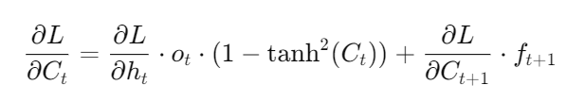
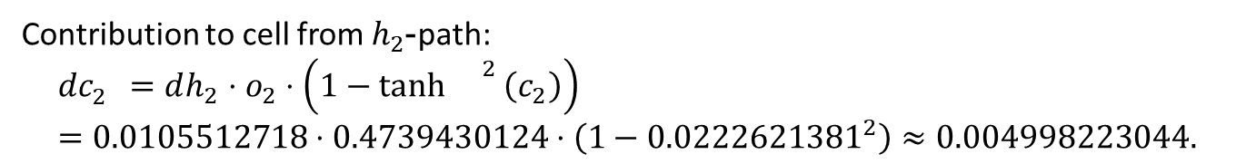
3. Gradient of Loss with Respect to the cell state
Contribution to cell from $h_{2}$-path:
$$dc_{2}^{}=dh_{2}⋅o_{2}⋅\left(1−{\tanh{}}^{2}\left(c_{2}\right)\right)=0.0105512718⋅0.4739430124⋅\left(1−{0.0222621381}^{2}\right)≈0.004998223044.$$
Dl w.r.t to h , o2 tanh2

Slide 28

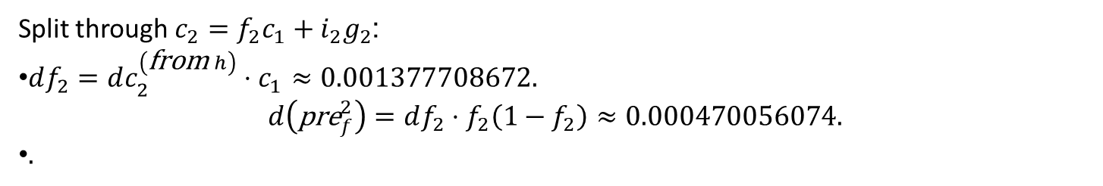
4. Gradient of Loss with Respect to Forget Gate
Split through $c_{2}=f_{2}c_{1}+i_{2}g_{2}$:
$df_{2}=dc_{2}^{\left(\text{from} h\right)}⋅c_{1}≈0.001377708672.$ $d\left({\text{pre}}_{f}^{2}\right)=df_{2}⋅f_{2}\left(1−f_{2}\right)≈0.000470056074.$
$.$

Slide 29
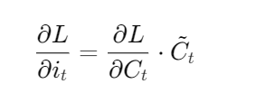
5. Gradient of Loss with Respect to Input Gate
$$di_{2}=dc_{2}^{\left(\text{from} h\right)}⋅g_{2}≈−0.001513700888. \\ d\left({\text{pre}}_{i}^{2}\right)=di_{2}⋅i_{2}\left(1−i_{2}\right)≈−0.000375540687$$

Slide 30
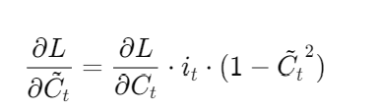
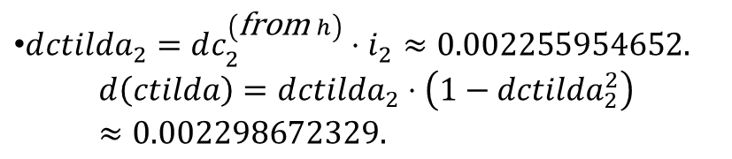
6. Gradient of Loss with Respect to Candidate cell state
$d{ctilda}_{2}=dc_{2}^{\left(\text{from} h\right)}⋅i_{2}≈0.002255954652.$ $d\left(ctilda\right)=d{ctilda}_{2}⋅\left(1−{dctilda}_{2}^{2}\right)≈0.002298672329.$

Slide 31
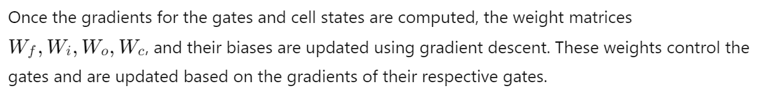
7. Weight updates
𝑑𝑊𝑖(2)=𝑑(pre𝑖2)⋅𝑥2≈−0.000375540687⋅(−0.3)=0.000112510709. 𝑑𝑈𝑖(2)=𝑑(pre𝑖2)⋅ℎ1≈−0.000375540687⋅0.1432246084≈−0.000053718322.
dbi(2) ​=d(prei2 ​)≈−0.000375540687
The cell gradient to be propagated into 𝑐1 ​ (from t=2) is:𝑑𝑐1(from future)=𝑓2⋅𝑑𝑐2(total)=𝑓2⋅𝑑𝑐2(from ℎ)≈0.5765544675⋅0.004998223044=0.002881747826.dc1(from future) ​=f2 ​⋅dc2(total) ​=f2 ​⋅dc2(from h) ​≈0.5765544675⋅0.004998223044=0.002881747826.

Slide 32
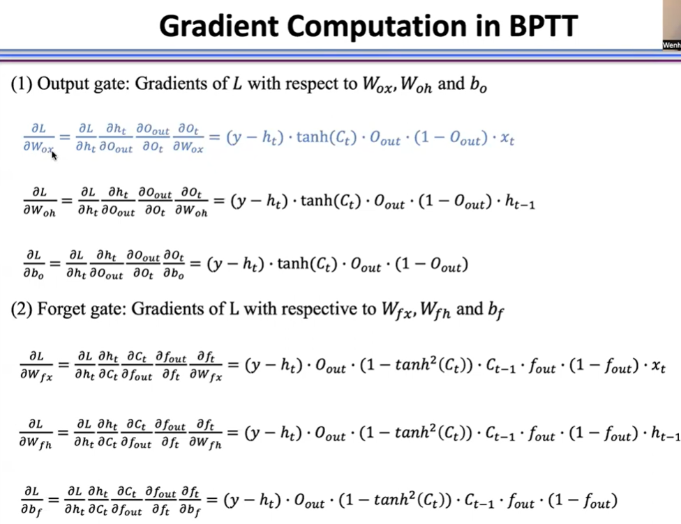

Slide 33
Applications
Both LSTMs and RNNs can be used for speech recognition, language modeling, and natural language processing (NLP). LSTMs are also used for sentiment analysis and video analysis. RNNs can be used to predict daily flood levels and solve ordinal or temporal problems.

